Slide 1
Transaction Definition
Unit of work that accesses one or more shared resources (usually databases)
– Set of one or more activities related to each other
– Must be completed together or not at all
– Cohesion of unit is normally mission critical
– Examples
  • ATM
  – Withdraw from one source, deposit to another
• Order System (e.g. online book store)
– Locate item, charge account, schedule shipment
• Medical System
– Identify medical state, dispense prescription

Slide 2
Transaction Properties (ACID)
Atomic
– Transaction must execute completely or not at all
Consistent
– Data in database is always in a consistent state (data integrity makes sense)
– A transactional system fulfills its responsibility for consistency by
ensuring that a transaction is atomic, isolated and durable
– Application developer must ensure that database has appropriate
constraints (primary keys, referential integrity, etc.) and that unit-of work
doesn’t result in inconsistent data
Isolated
– Transaction executes without interference
Durable
– Changes are not lost if the system crashes

Slide 3
EJB Transaction Support
EJB is designed to support transactions automatically.
Declarative (CMT)
– Easy
– Transaction management controlled through deployment descriptor
(􀃆 transaction attributes for individual enterprise bean methods)
Programmatic (BMT)
– Complex
– Explicit transaction demarcation
– Direct programming calls to Java Transaction Service (JTS) API
– Transaction management code mixed with business code
(change in transactional behavior requires change in business code)

Slide 4
Transaction Scope
One or more tasks that operate as a unit of
work; succeed or be rolled back together
Tasks
– EJB methods
Unit of Work
– Each bean visited by the methods during a thread of
execution depending on bean transaction attributes
– Ends when thread of execution
    Completes normally
    An exception is thrown ( type)
    Transaction is rolled back

Slide 5
Transaction Attributes
EJB servers can manage transactions implicitly, based on the transaction attributes established at deployment time.
Supports Transactions
– Supports
– Required
– RequiresNew
– Mandatory
Transactions not Supported
– NotSupported
– Never
Set a transaction attribute for the entire EJB or for individual methods (flexibility)

Slide 6
Setting a Transaction Attribute
<ejb-jar>
...
<assembly-descriptor>
<container-transaction>
<method>
<ejb-name>MyEJB</ejb-name>
<method-name>*</method-name>
</method>
<trans-attribute>Required</trans-attribute>
</container-transaction>
</assembly-descriptor>
</ejb-jar>

Slide 7
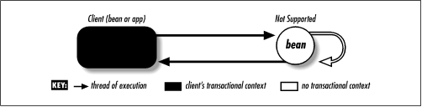
Not Supported
Transaction is suspended during the method of the invoked EJB;resumes when method complete
Transaction scope is not propagated to invoked EJB or anything it invokes

Slide 8
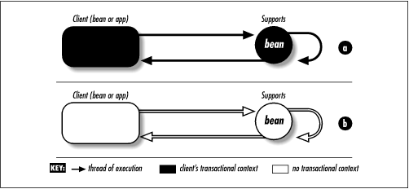
Supports
Joins the transaction context if invoked as part of a transaction (A)
Does not require a transaction; can be invoked outside of a transaction context (B)

Slide 9
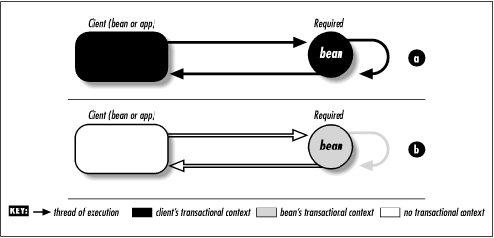
Required
Enterprise bean method must be invoked within the scope of a TX
Joins the transaction context if invoked as part of a transaction (A)
Initiates its own transaction context if invoked outside of a transaction(B)

Slide 10
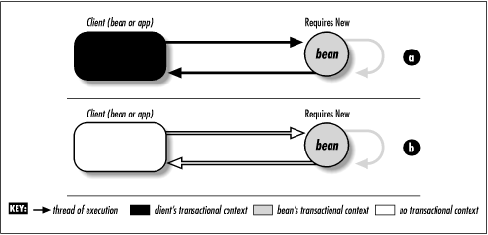
RequiresNew
A new transaction is always started.
Initiates its own transaction context whether called within an existing transaction context (A) or outside of a transaction context (B)
Initiated transaction completes prior to returning to caller

Slide 11
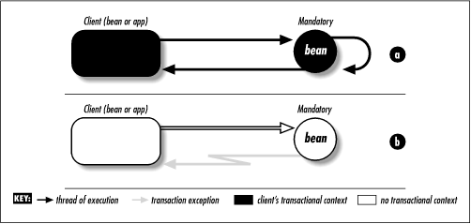
Mandatory
Joins the transaction context if invoked as part of a transaction (A)
Throws a Transaction Exception if not called within a transaction
context (B) (TransactionRequiredException for Remote Clients;
TransactionRequiredLocalException for Local Clients)

Slide 12
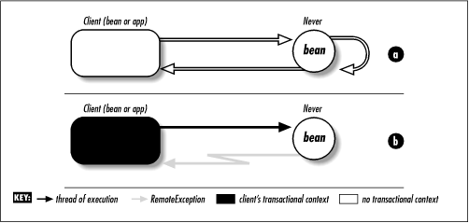
Never
EJB method must not be invoked within the scope of a transaction
Throws a Transaction Exception if called within a transaction context
(A) (RemoteException to Remote Clients; EJBException to Local
Clients)
Must be invoked outside of a transaction context (B)

Slide 13
Isolation and Database Locking
What happens when two or more transactions attempt to access the same Data:
– Dirty Reads
  • First transaction reads uncommitted changes from a second transaction that may eventually be rolled back
– Repeatable Reads
• Data guaranteed to be the same if read multiple times during the same transaction; implemented with locks or snapshots
  • Opposite: nonrepeatable read
– Phantom Reads
• First transaction sees new rows added by second transaction after beginning of the first transaction

Slide 14
Database Locks
• How to prevent overlapping transactions from viewing the other’s data?
– Read Lock
• Data is prevented from changing while transaction is in progress
• Current transaction is prohibited from making changes
– Write Lock
• Prevents other transactions from modifying the data
• Permits dirty reads by other transactions (and by the current TX itself)
– Exclusive Write Lock
• Prevents other transactions from reading and modifying data
• Prevents dirty reads
– Snapshots - frozen view of data
• Every transaction gets its own snapshot of the data

Slide 15
Transaction Isolation Levels
• Defined in terms of the isolation conditions (dirty reads, repeatable reads, and phantom reads)
• Used in DBS to describe how locking is applied to data within a transaction:
– Read Uncommitted
• Can read data being modified by another transaction
• Allows dirty, non-repeatable, and phantom reads
– Read Committed
• Cannot read data being modified by another transaction
• Allows non-repeatable and phantom reads; prevents dirty reads
– Repeatable Read
• Cannot change data being read by another transaction
• Allows phantom reads; prevents dirty and non-repeatable reads
– Serializable
• Transaction has exclusive read/write privileges to data
• Different transactions can neither read or write same data

Slide 16
Specifying Isolation Level
• EJB deployer sets transaction isolation levels in a vendor specific
way if the container manages the transaction
<weblogic-ejb-jar>
<transaction-isolation>
<!-- TRANSACTION_SERIALIZABLE
TRANSACTION_READ_COMMITTED
TRANSACTION_READ_UNCOMMITTED
TRANSACTION_REPEATABLE_READ
-->
<isolation-level>TRANSACTION_READ_COMMITTED</isolation-level>
<method>
<ejb-name>Account</ejb-name>
<method-name>*</method-name>
<method>
</transaction-isolation>

Slide 17
Message Driven Bean Transactions
• Valid Values
– NotSupported
– Required
• Client transaction context not propagated to MDB
– Supports, RequiresNew, Mandatory, and Never are relative to client

Slide 18
Exceptions within Transactions
• System Exceptions (e.g. NullPointerException, EJBException)
– Container automatically rolls back transaction
– Bean instance is discarded
• ApplicationException (e.g. AccountOverdrawException)
– Container does not automatically rollback transaction
– Exception delivered to client
– Client optionally signals rollback
• EJBContext.setRollbackOnly()

Slide 19
Distributed Transaction
• In addition to managing transactions in its own environment, an EJB server can coordinate with other transactional systems
E.g. EJBs on different EJB servers
• EJB server would cooperate to manage the transaction as one unit-of-work
• Two-phase commit (2-PC) is required

Slide 20
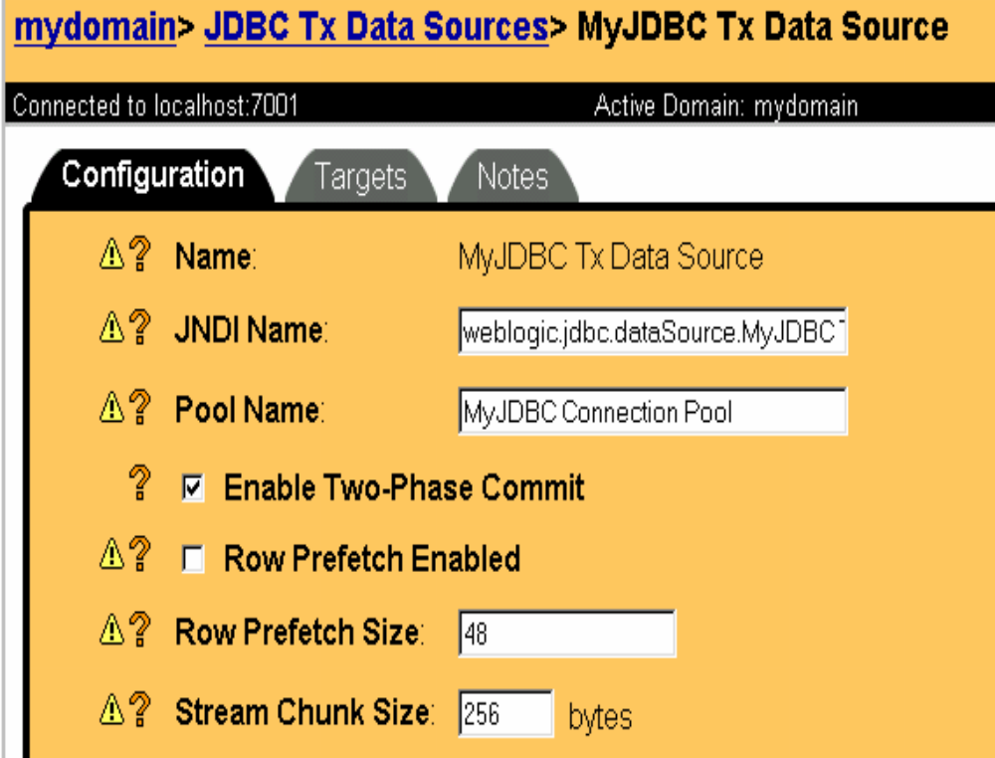
Enable JTS Transactions for Connection Pool

Slide 21
Enable JTS Transactions in Entity Bean
<weblogic-rdbms-jar>
<weblogic-rdbms-bean>
<ejb-name>Account</ejb-name>
<data-source-name>java.jdbc.txDataSource
</data-source-name>
<table-name>Account</table-name>

Slide 22
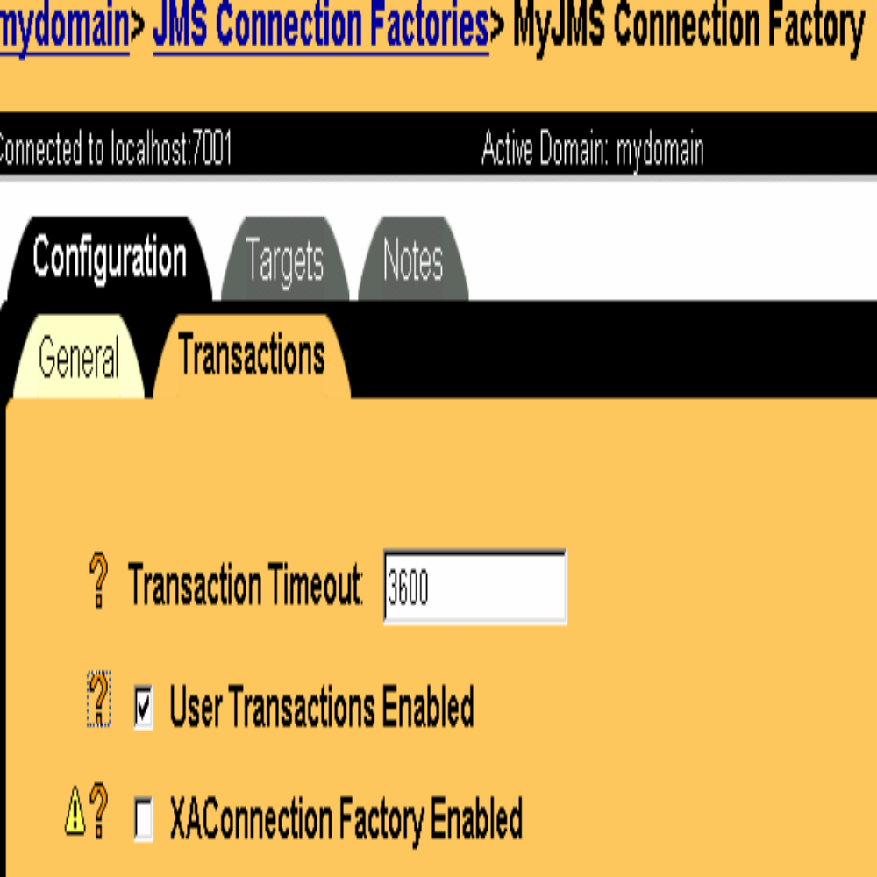
Enable JTS Transactions for JMS

Slide 23
Bean Types and Transactions
Entity
– In EJB 1.1 must be container managed
– May force a rollback with setRollbackOnly()
Stateless Session
– Transactions simple. Abort by throwing EJBException
Stateful Session
– E.g. shopping cart ( Caching)
– What about the conversational state?
– Have to respond to transaction aborts to keep conversational state consistent

Slide 24
Stateful Session Bean and Transactions
• Can implement SessionSynchronization interface
– afterBegin(), beforeCompletion(), afterCompletion(boolean)
If afterCompletion is false, you can roll back the conversational state
SessionSynchronization can not be implemented with vbean-managed TX

Slide 25
Programmatic Transactions
Bean programmer is responsible for issuing begin(), commit(), and abort() calls in application code
Discouraged
  Why not let the container do it?
  Flexibility and fine grained control
Use Java Transaction API (JTA)
– Simple layer over Java Transaction Service (JTS) which is an implementation of the CORBA Object Transaction Service (OTS)

Slide 26
User Transaction
Required EJB Transaction interface (javax.transaction.UserTransaction)
Set transaction-type on bean-managed transaction (BMT) in deployment descriptor
Provides access to transaction service
– Can start and commit
– Can mark that transaction must be rolled back
Client and server components can use
Container/Server does not have to expose JTS API to the bean

Slide 27
Code Example
public void transfer(AccountRemote from,AccountRemote to, float amount ) throws AccountException {
UserTransaction tx = null;
try {
tx = ctx.getUserTransaction();
tx.begin();
// perform JDBC operations and transfer the money
tx.commit();
}
catch (Exception ex) {
tx.setRollbackOnly();
throw new AccountException();
}
}

Slide 28
Programmatic Transactions in EJB
Allowed in Session Beans
<session>
...
<transaction-type>Bean</transaction-type>
– Stateless Session Beans must begin/end in same method
– Stateful Session Beans may begin/end in separate methods
(although not advised)
EJB 1.1 disallows this for Entity Beans
MDB - TX scope must begin and end within the onMessage() method
Bean controls transactions programmatically

Slide 29
Transactional Clients
End user can also control transactions
UserTransaction ut = (UserTransaction);
jndiContext.lookup(“javax.transaction.UserTransaction”);
ut.begin();
// perform multiple operations on beans
account1.deposit( 34 );
account2.withdraw( 34 );
ut.commit();

Slide 30
Client Issues
Lots of network traffic required when client manages transactions
More complicated
Should have asked a session bean to perform the set of operations over on the server
Transactions should be short

Slide 31
Performance Implications
Avoid distributed transactions across multiple resource managers and/or multiple transaction managers
– Consider JMS synchronization
Avoid client control of transaction boundaries
– Try to encapsulate transactional business operations in session beans

Slide 32
EJB Transaction Summary
Supports EJB goal of removing middleware programming burden from bean programmer
Declare transactional requirements in deployment descriptor
• Transactions have performance implications
– Limit client control, distributed transactions
– Can control frequency of ejbLoad() and ejbStore()

